Slide 1

The K-Armed Bandit Problem
Notes:
1

Slide 2
Objectives
Define reward
Understand the temporal nature of the bandit problem
Define k-armed bandit
Define action-values
The K-Armed Bandit Problem
2
Notes:
2

Slide 3
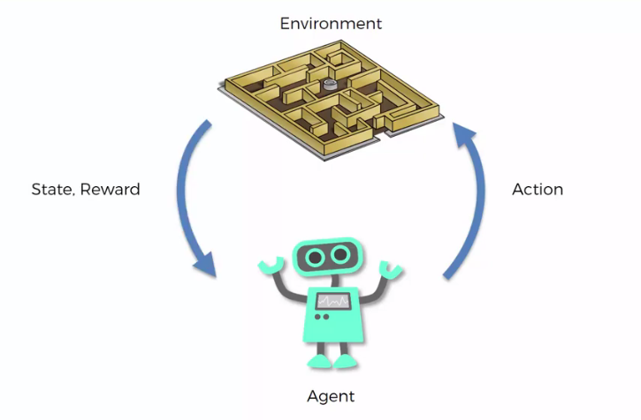
Define reward
What is the reward?
Give your opinions
3
The K-Armed Bandit Problem
Notes:
3

Slide 4
Define reward
Reward is a scalar feedback signal provided by the environment to the learning agent.
It indicates how well the agent is performing a given task at a particular state and time step.
The reward signal serves as the primary mechanism for shaping the behavior of the agent, guiding it towards achieving its objectives.
4
The K-Armed Bandit Problem
Notes:
4

Slide 5
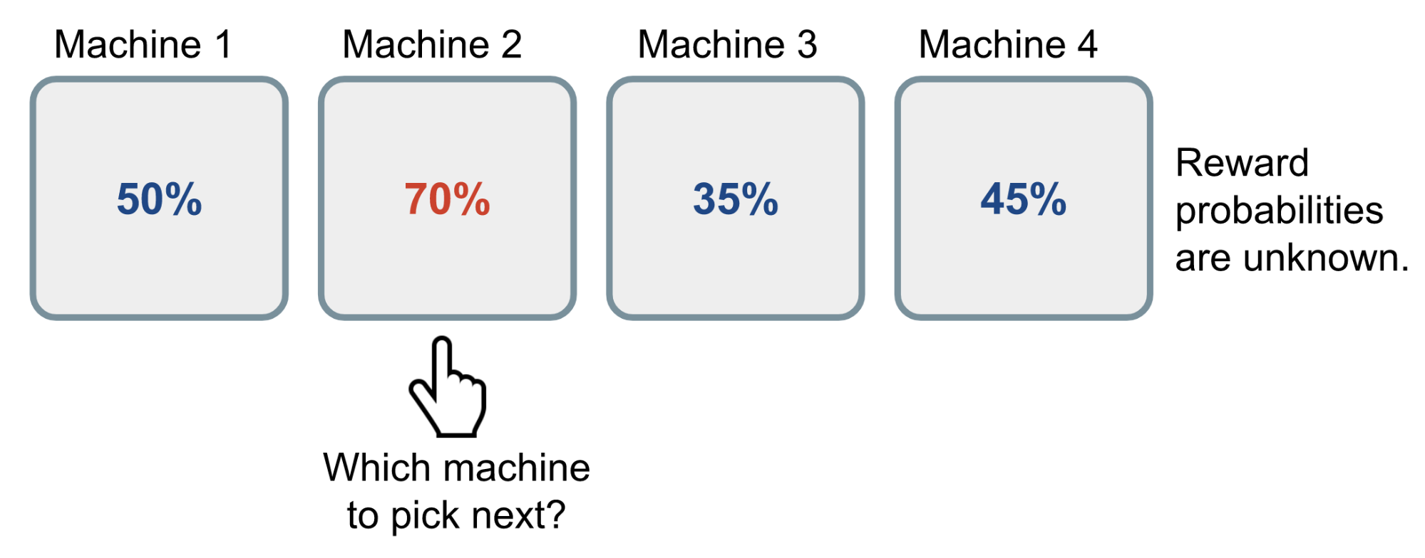
The bandit problem
The problem involves a gambler facing a row of slot machines (bandits), each with an unknown probability distribution of providing rewards.
The gambler's objective is to maximize the total reward obtained over a series of plays.
5
The K-Armed Bandit Problem
Notes:
5

Slide 6
The bandit problem
The challenge arises from the trade-off between exploration and exploitation.
Exploitation involves playing the arm that appears to provide the highest reward based on past experience.
Exploration involves trying out different arms to learn more about their reward distributions.
The bandit problem has applications in various fields, including clinical trials, online advertising, and reinforcement learning.
6
The K-Armed Bandit Problem
Notes:
6

Slide 7
The bandit problem
Solving the bandit problem efficiently is essential for optimizing resource allocation and decision-making in these domains.
7
The K-Armed Bandit Problem
Notes:
7

Slide 8

Define k-armed bandit
Scenario: Mr HoaDNT pulls machine k sample from unknow reward distribution
Problem: given a finite number of pulls T, how can Mr HoaDNT optimize his winning? → give your opinions !
8
The K-Armed Bandit Problem
Notes:
8

Slide 9
Define k-armed bandit
It is a classic problem in reinforcement learning and decision theory.
It is a simplified version of sequential decision making under uncertainty.
In the K-Armed Bandit Problem, an agent is faced with a row of K different slot machines, each with an unknown probability distribution of yielding rewards.
9
The K-Armed Bandit Problem
Notes:
9

Slide 10
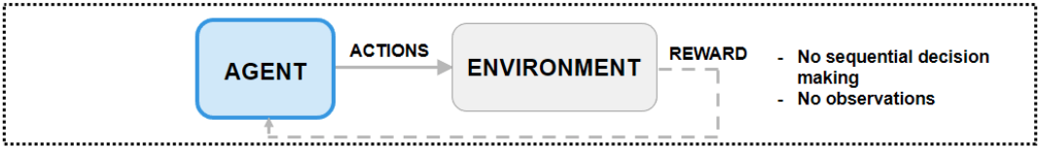
Define k-armed bandit
The agent's objective is to maximize its cumulative reward over a series of trials, where in each trial, it selects one of the K arms (slot machines) to pull and receives a reward based on the outcome.
10
The K-Armed Bandit Problem
Notes:
10

Slide 11
Define k-armed bandit
In bandit problems, an agent selects an action given the initial observation, it receives a reward, and the episode terminates. → the agent action does not affect the next observation.
The environment has no dynamics, so the reward is only influenced by the current action and the current observation
11
The K-Armed Bandit Problem
Notes:
11

Slide 12
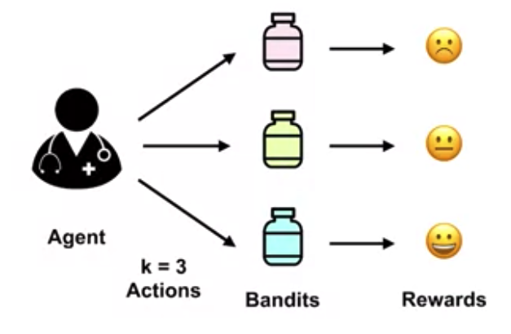
Define action-values
The medical trial example is a case of the k-armed bandit problem. In the k-armed bandit problem, we have a decision-maker or agent, who chooses between k different actions, and receives a reward based on the action he chooses.
12
The K-Armed Bandit Problem
Notes:
12

Slide 13
Define action-values
The role of the agent is played by a doctor.
The doctor has to choose between three different actions, to prescribe the blue, red, or yellow treatment. Each treatment is an action.
Choosing that treatment yields some unknown reward.
The welfare of the patient after the treatment is the reward that the doctor receives.
13
The K-Armed Bandit Problem
Notes:
13

Slide 14
Define action-values
For the doctor to decide which action is best, we must define the value of taking each action. We call these values the action values or the action value function.
The expected cumulative reward the agent will receive by taking action A in state S
14
The K-Armed Bandit Problem
Notes:
14

Slide 15
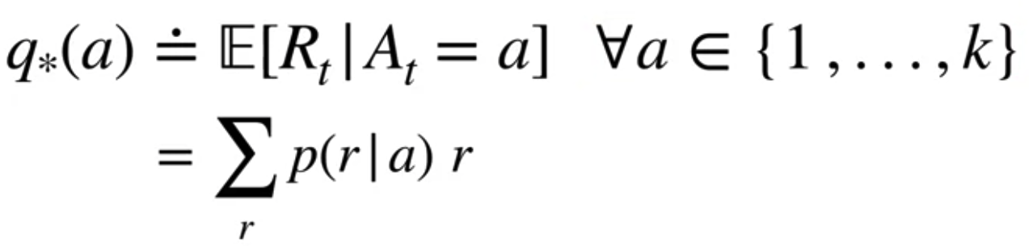
Define action-values
Mathematically, the action-value function can be defined as the expected reward
q star of a is defined as the expectation of R_t, given we selected action A, for each possible action one through k.
This conditional expectation is defined as a sum over all possible rewards.
Inside the sum, we have multiplied the possible reward by the probability of observing that reward..
15
The K-Armed Bandit Problem
Notes:
15

Slide 16
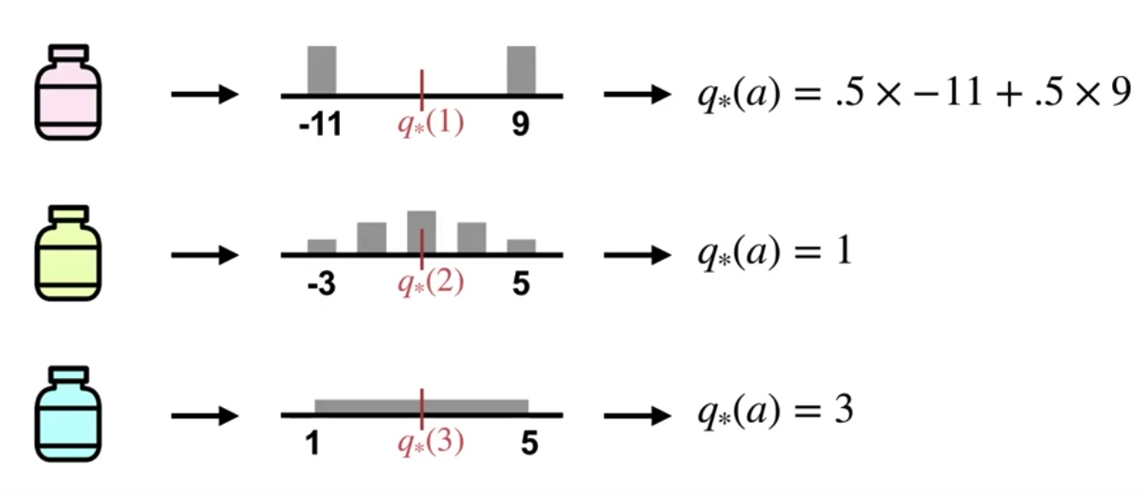
Define action-values
Example for calculating action value
16
The K-Armed Bandit Problem
Notes:
Simply multiply the probability of failure by the reward when failed, plus the probability of success, times reward when succeeded
16

Slide 17
Summary
Define reward
Understand the temporal nature of the bandit problem
Define k-armed bandit
Define action-values
The K-Armed Bandit Problem
17

Slide 18
Q & A
The K-Armed Bandit Problem
18

